Slide 1
CS501 Pantry Pal
Final Presentation
Date 5/6/2025
Songhan Min
Saiwang Xiang
Haoran Zhang

Slide 2
Contents
Date
Date 5/6/2025
Introduction
01
Core Features
02
Demo
03
Feedback & improvements
04

Slide 3

Project overview
Date
Date 5/6/2025
Pantry Pal is a user-centric recipe discovery app designed to minimize food waste and simplify meal planning by leveraging ingredients users already have. Targeting cooking enthusiasts and beginners alike, the app combines practicality with playful interaction, empowering users to cook creatively while reducing unnecessary grocery purchases.

Slide 4
Core Features
Date
Date 5/6/2025
Features
Ingredient-Based Recipe Search
Pantry Pal enables users to discover recipes based on ingredients they already have. This primary feature helps reduce food waste and simplifies meal planning.
"Shake for Surprise" Feature
This playful feature utilizes the device's accelerometer sensor to provide random recipe suggestions when the user shakes their phone.
Personal Cookbook (Saves)
Users can save favorite recipes locally for offline access. Also, we have a remote database in case you want to access it on a different platform.
Pantry & Grocery Helper
This feature allows users to track pantry items and automatically generate shopping lists based on missing ingredients for recipes they want to try.

Slide 5
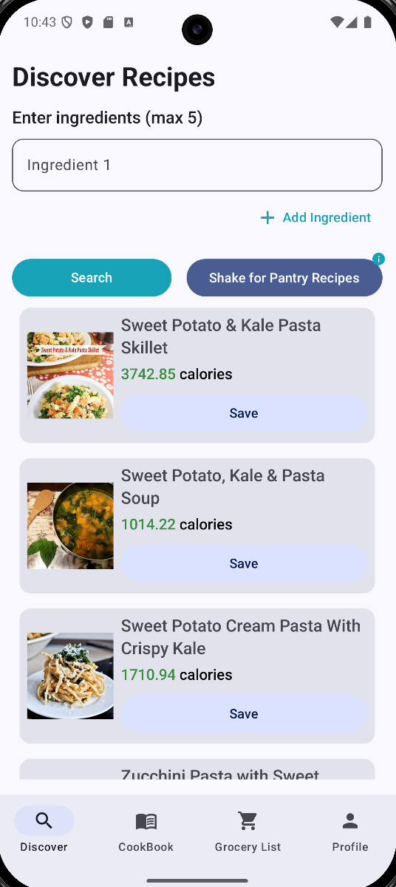
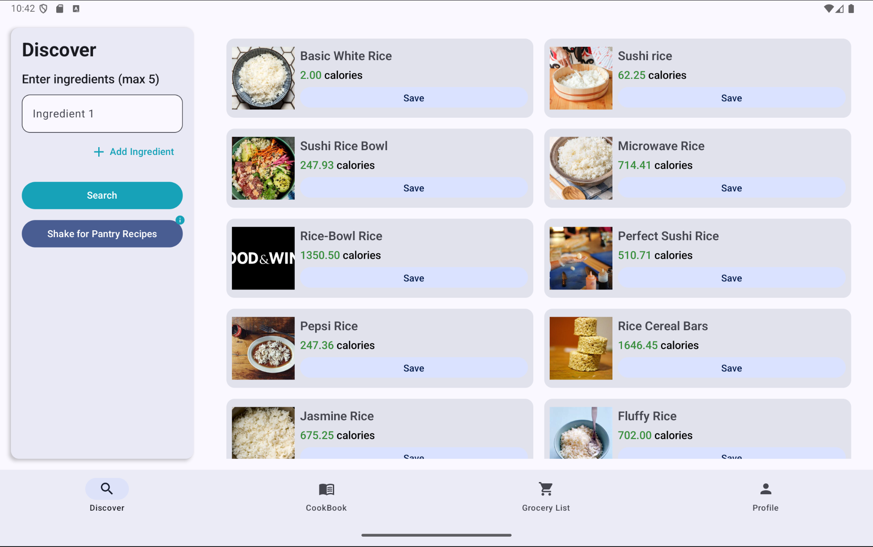
DEMO
Date
Date 5/6/2025

Slide 6
Feedback
Date
Date 5/6/2025
User’s Feedback
Descriptions
Intuitive Interface
They found the app easy to navigate without instruction
Shake Feature
Most of them enjoyed the "shake for surprise" feature, finding it novel and engaging
Responsive Design
They specifically praised the tablet multi-pane layout as efficient and well-organized. Tablets are more often used in Kitchen
Data Access
They valued being able to access saved recipes without an internet connection or on a different platform

Slide 7
Improvements
Date
Date 5/6/2025
Areas for Improvement
Descriptions
Search Refinement
Users requested more filtering options (dietary restrictions, cuisine type, meal type)
Recipe Scaling
Users wanted the ability to scale recipes for different serving sizes
Cooking Mode
Users requested a dedicated cooking mode with step-by-step instructions and timers
Social Sharing
Users wanted to share recipes with friends and family

Slide 8
Thank you so much!
Date
Date 5/6/2025
You will find Pantry Pal in Google play soon!
Songhan Min
Saiwang Xiang
Haoran Zhang

